Slide 1

Internal tool
Notes:
File #21963457
2004 : looking for an internal tool
Developed it based on Siebel Systems
It worked very well - Tool was asked for by customers
So : decided to build own tool to bring it to the market !

Slide 2

Being able to present is first need when looking for money!
Notes:
File #19121335S
So I know needed to go and look for money again
I subscribed for an elevator pitching competition
Being able to present = 1st need when looking for money !
I won the elevator pitching contest
Being a female was again an advantage !

Slide 3

1 million €
Notes:
File #19547875
I raised 1 million € with CVWarehouse
2006 : Womed Award → Executive Research
Being a female entrepreneur has its advantages !
And the price was : and MBA course ☺
But I also needed branding for Cvwarehouse !

Slide 4

Identify Yourself

Slide 5

Give Relevant background

Slide 6

Explain what you solve

Slide 7
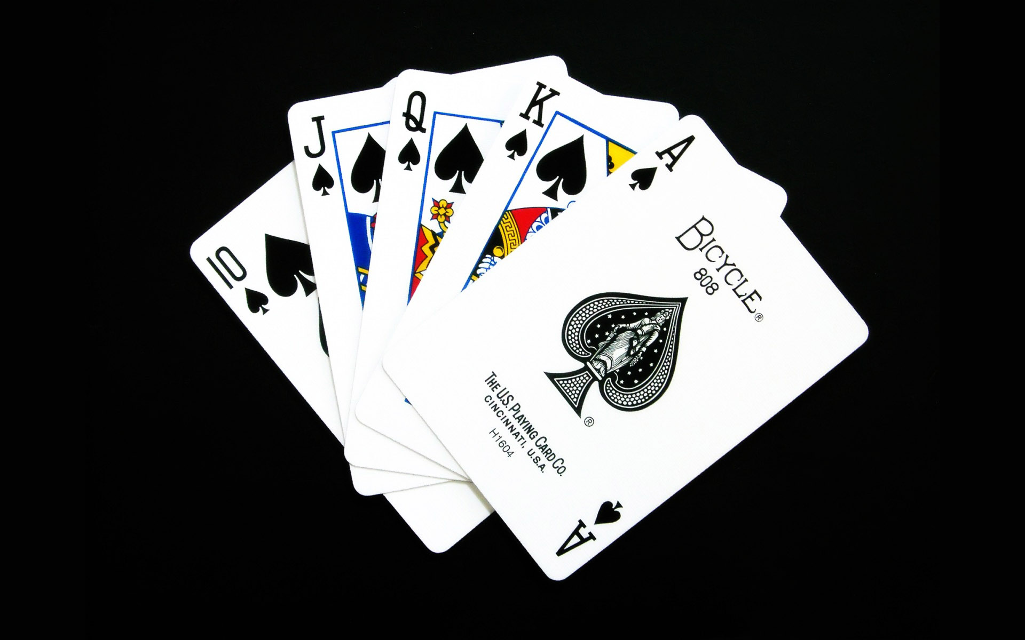
Play your cards ! Build trust through references

Slide 8

Why are you better ?

Slide 9
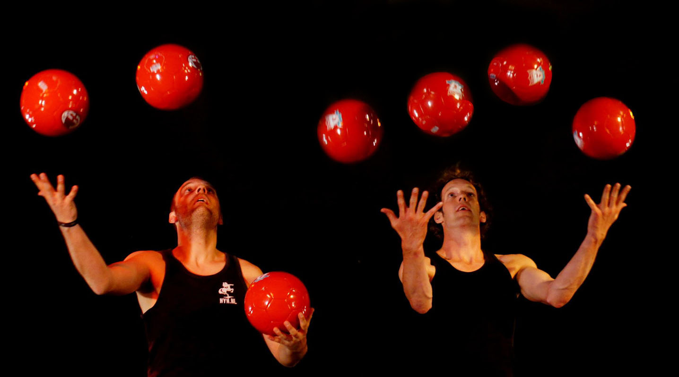
Where are you now ?

Slide 10
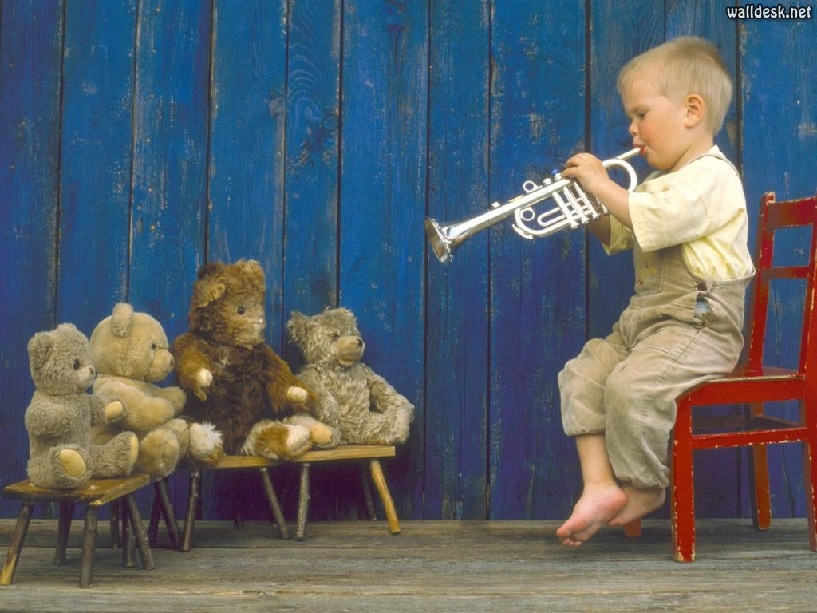
Target the right audience

Slide 11

What are you looking for exactly ?

Slide 12
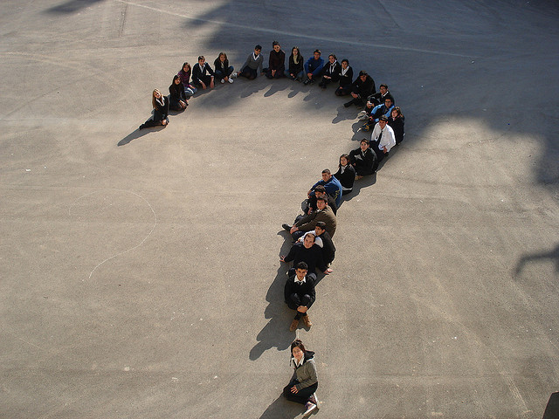
Embrace questions

Slide 13
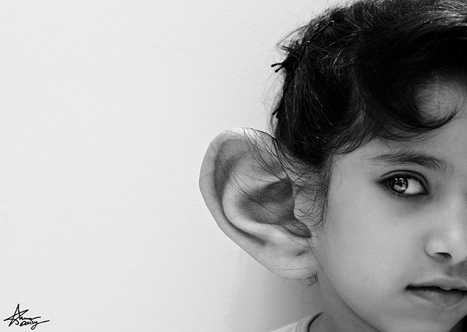
Listen carefully

Slide 14
Summary
Identify Yourself
Give Relevant background
Explain what you solve
Build trust through references
Why are you better ?
In which phase are you now ?
Target the right audience
What are you looking for exactly ?
Embrace questions and feedback

Slide 16


